Slide 1
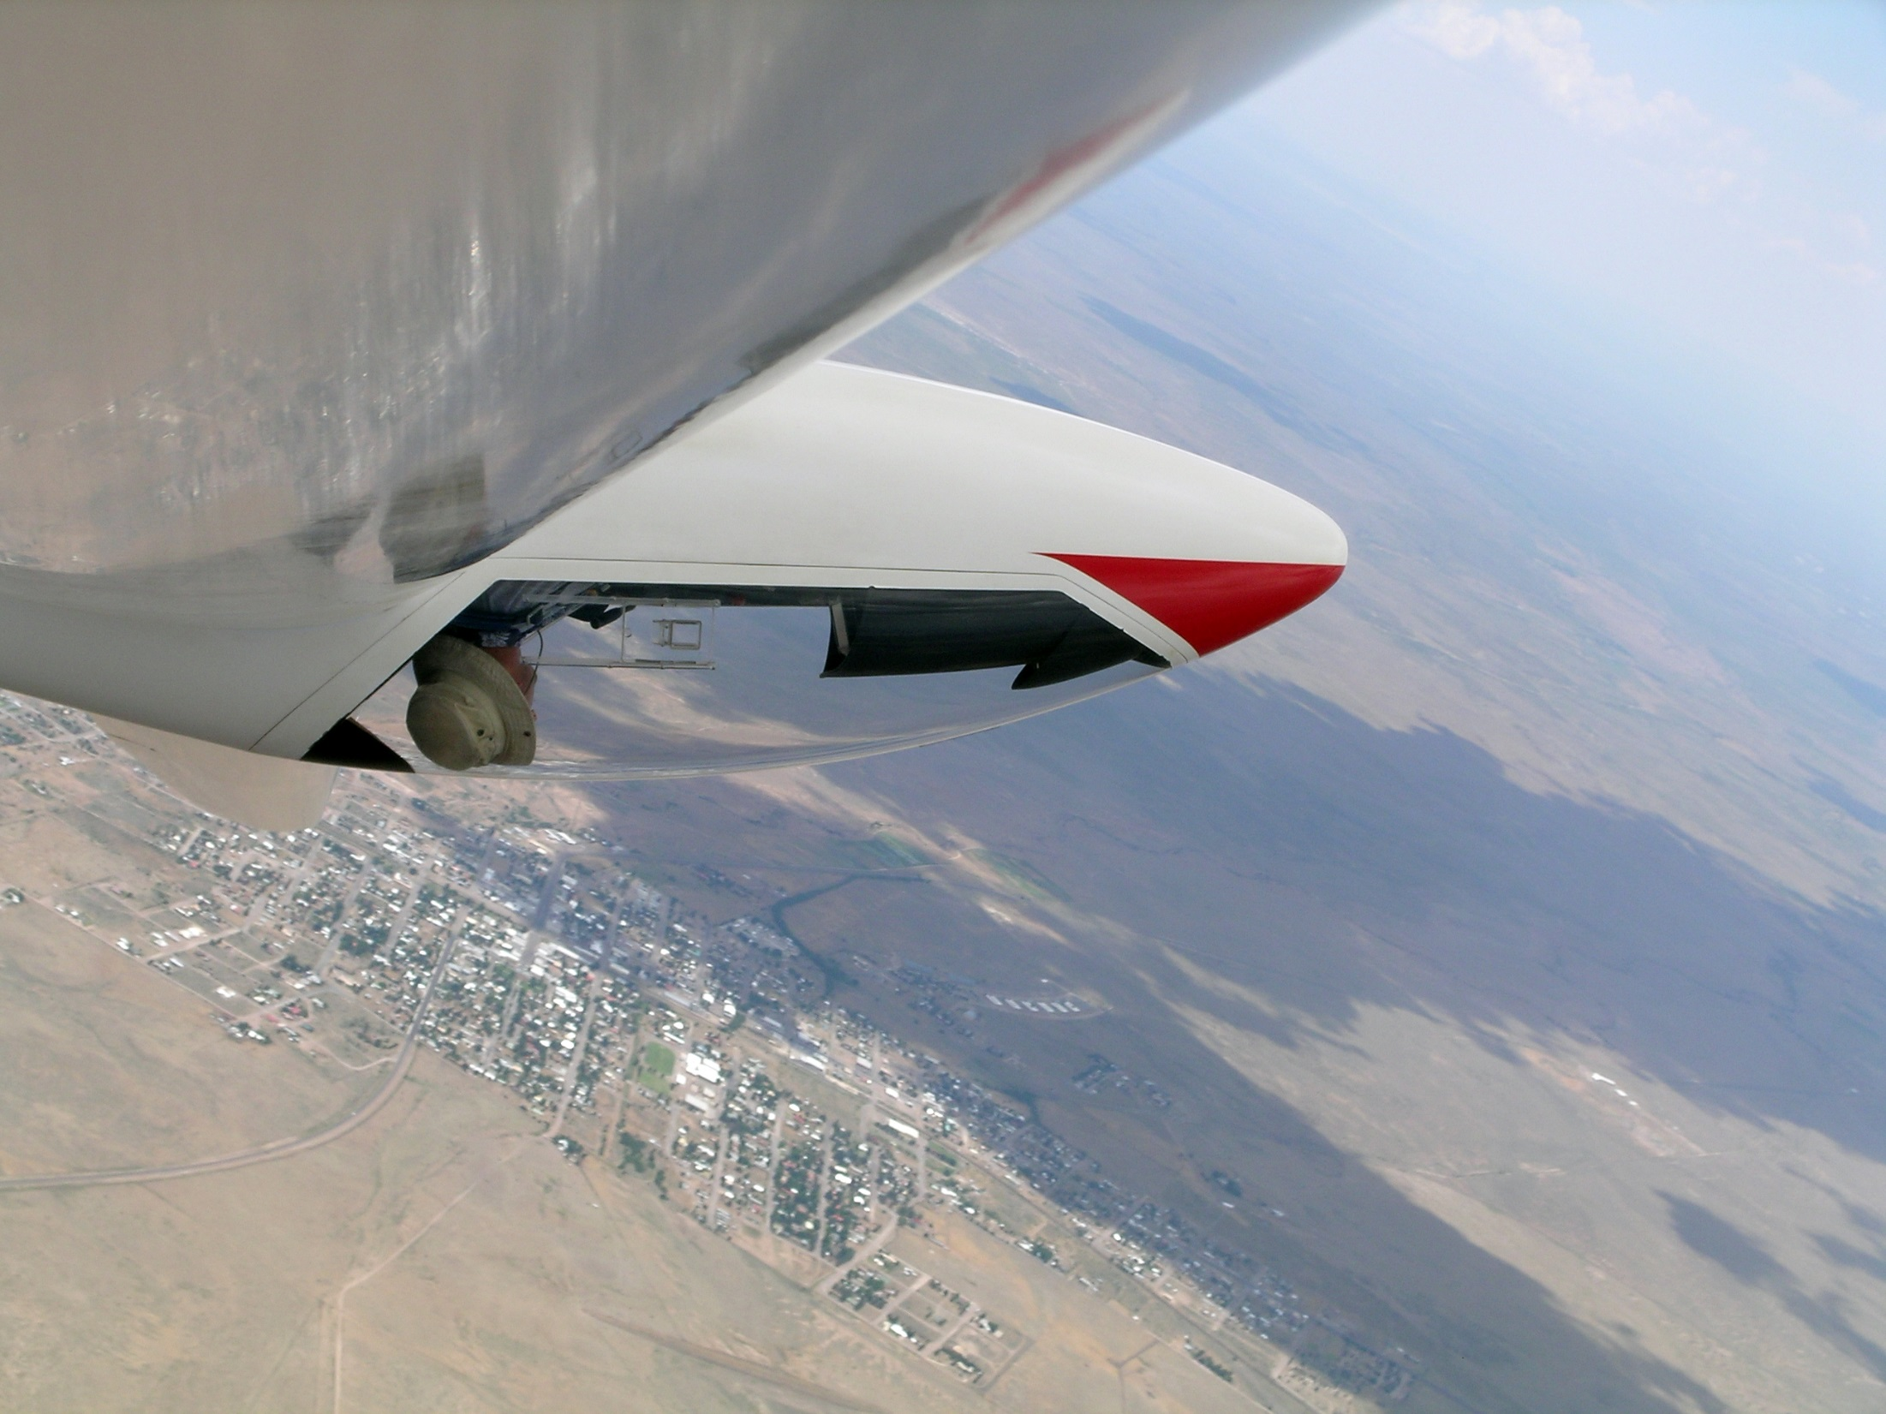
Oh, the Places you’ll go… Soaring
Chris Ruf
Feb 7 2015

Slide 2
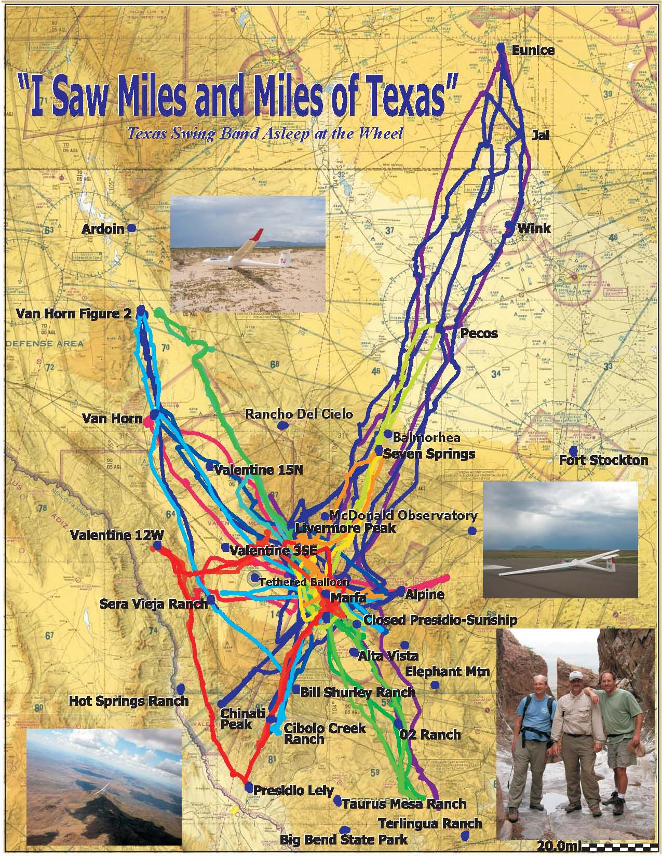
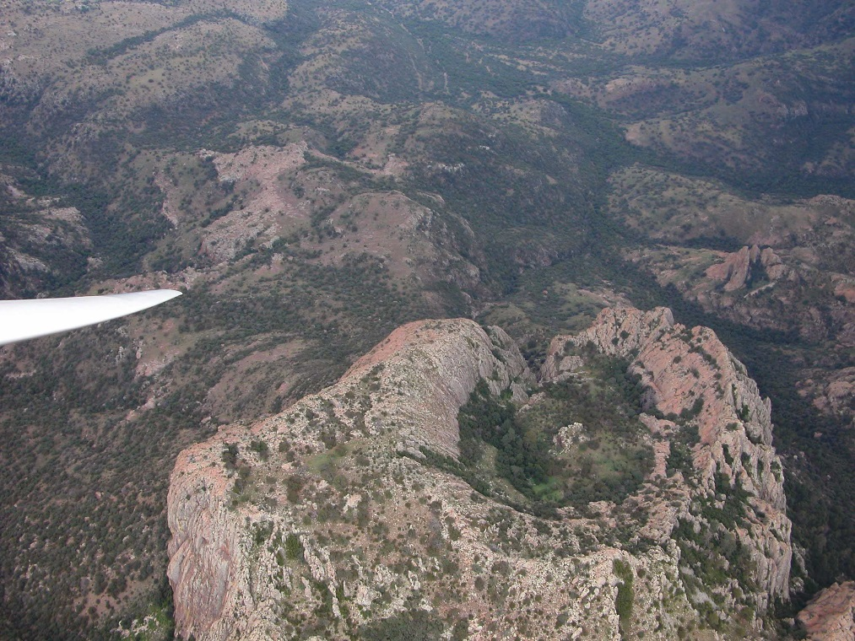
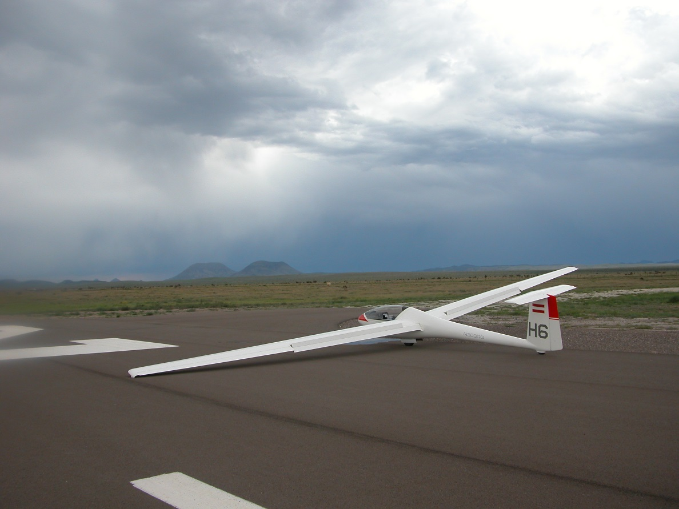

Slide 3
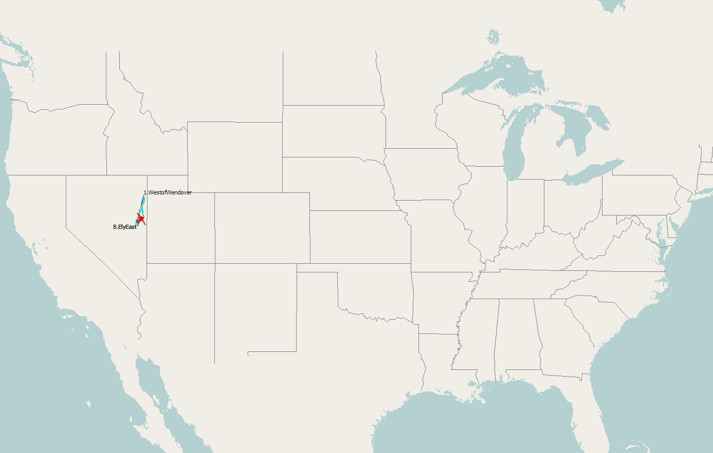
Ely, Nevada, Nimbus 3DM, Carl Herold & Chris Ruf
Where can a thermal take you?

Slide 4
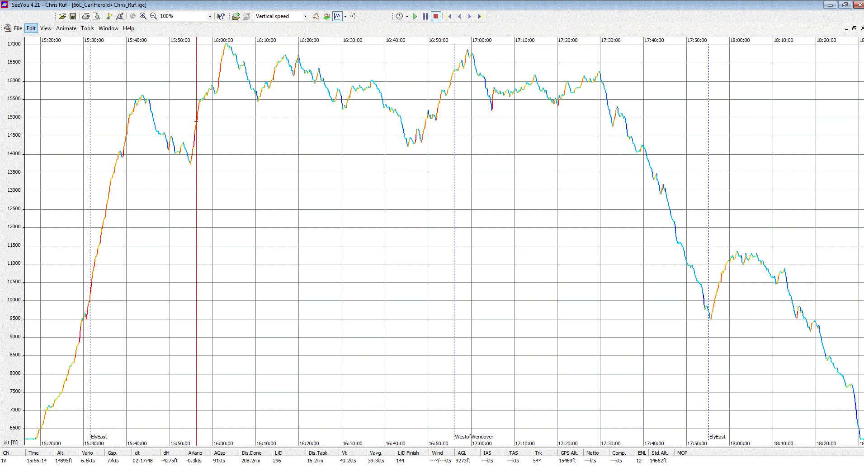
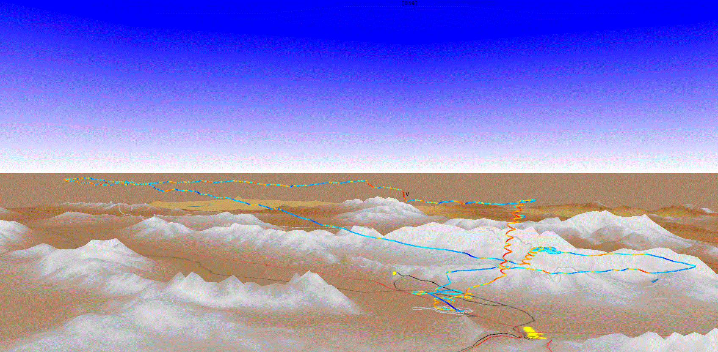
Ely, Nevada, Nimbus 3DM, Carl Herold & Chris Ruf
Where can a thermal take you?

Slide 5
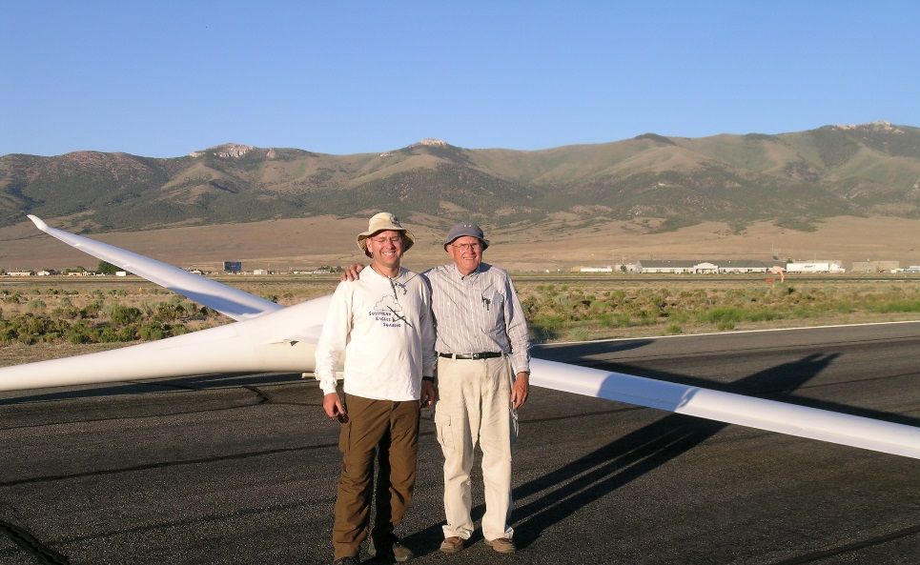
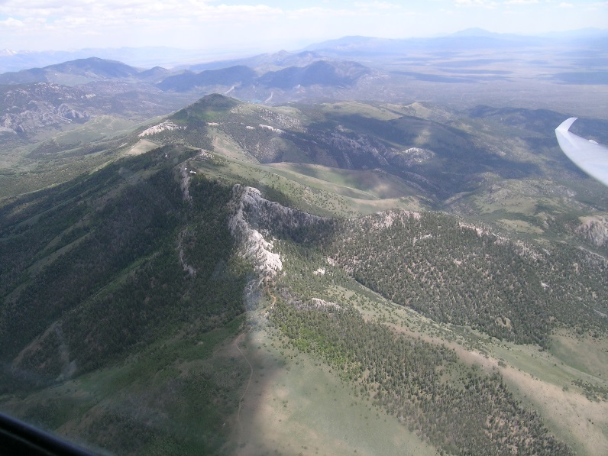
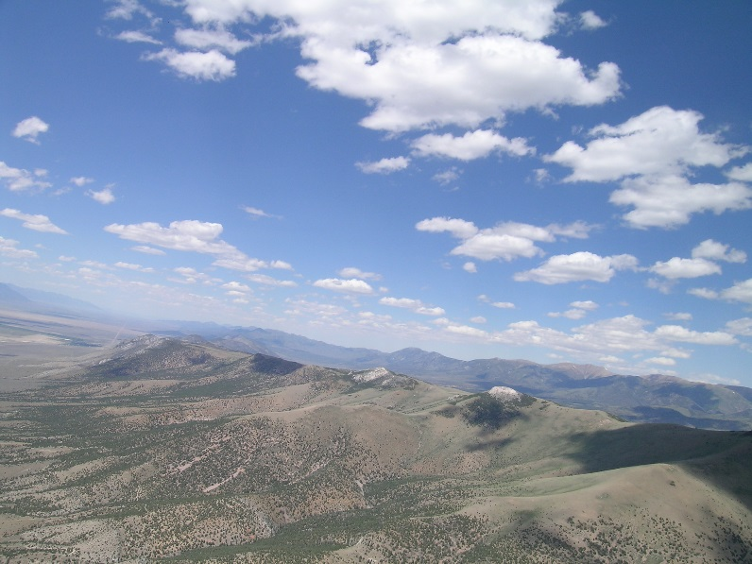
Ely, Nevada, Nimbus 3DM, Carl Herold & Chris Ruf
Where can a thermal take you?

Slide 6
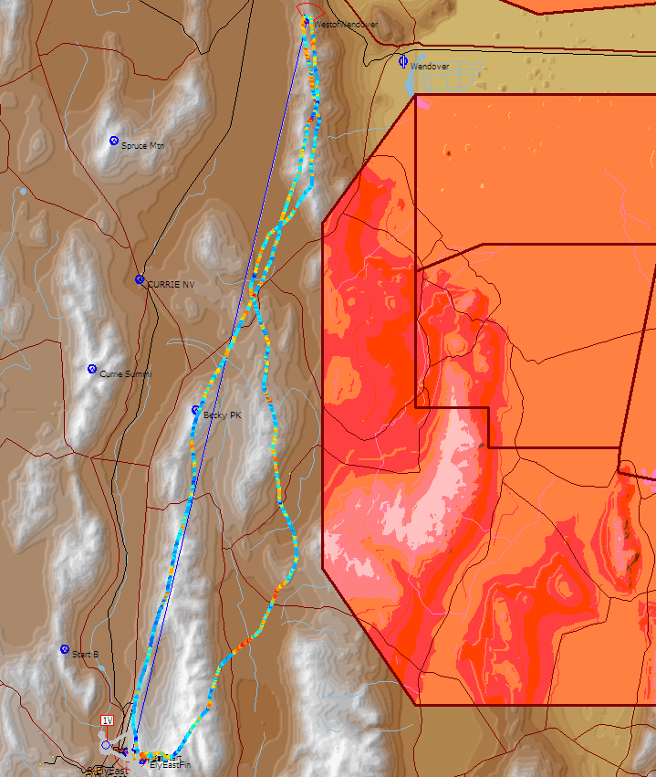
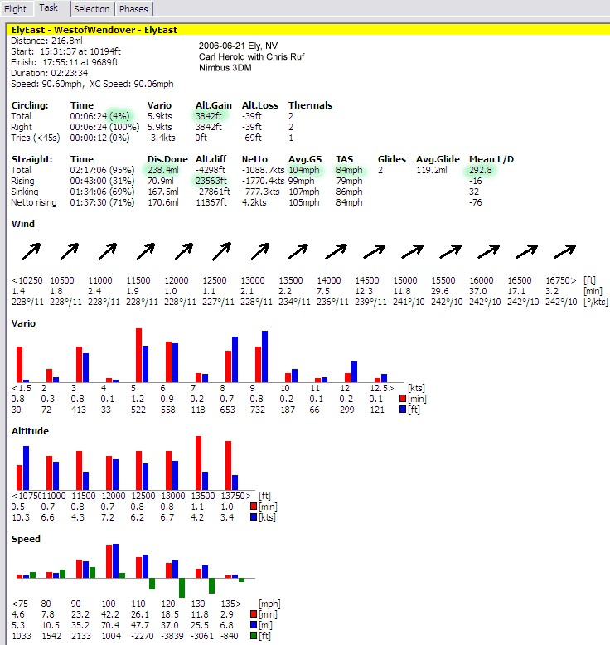
Ely, Nevada, Nimbus 3DM, Carl Herold & Chris Ruf
Where can A thermal take you? 238miles on 1 thermal
4% circling, 108mi N, 108mi S
292:1 L/D
90.6 mph for 217 miles
84mph IAS
A 24% increase in Groundspeed vs Indicated Airspeed
That is really impressive!

Slide 7
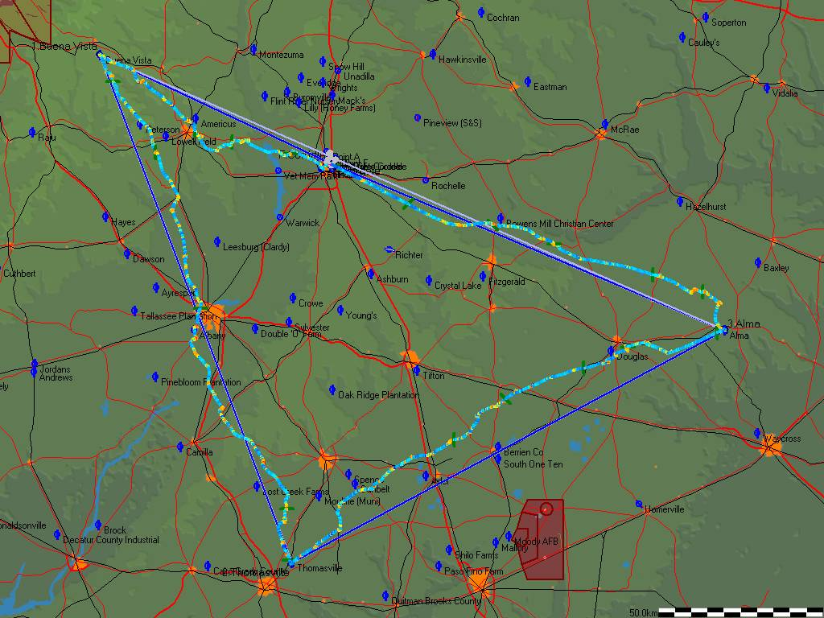
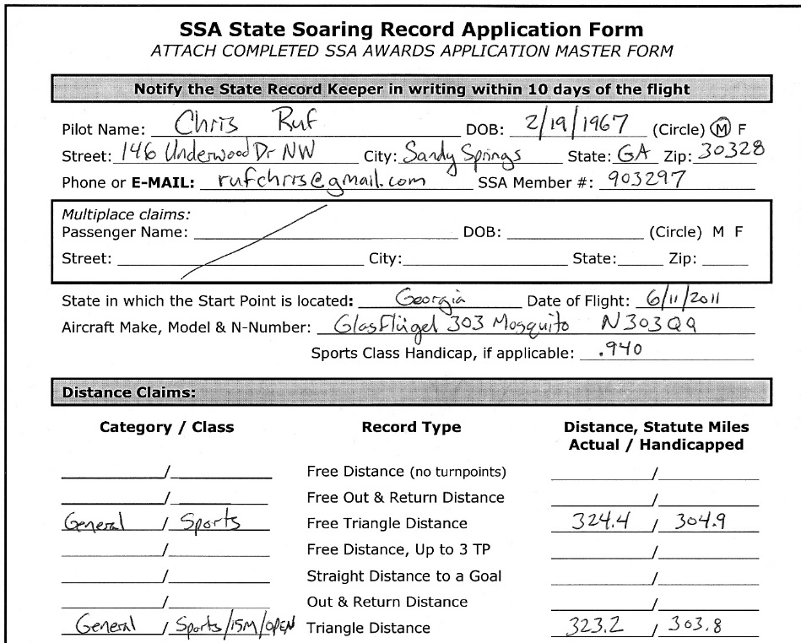
500K Triangle, Cordele, Chris Ruf

Slide 8
Warm Springs to Cordele O&R. Reasonable task if you are careful the first few miles. Wally, Tim, Dieter[Cirrus], Chris have done it from LaGrange and/or Warm Springs. 271km/168mi

Slide 9
Bronze Badge Requirements
Complete the ABC Training Program with the C Badge Awarded.
Log at Least 15 Solo Hours in Gliders. This Time Must Include 30 Solo Flights with at Least 10 Flights Flown in a Single-Place Glider if Possible.
Log at Least 2 Flights, Each Having Duration of Two Hours or More.
Perform at Least 3 Solo Spot Landings in a Glider Witnessed by an SSAI. The Accuracy and Distance Parameters Established Should be Based on Glider Performance Data, Current Winds, Runway Surface, and Density Altitude. As a Guideline, a Maximum Distance of 400 Feet Would be Acceptable for a Schweizer 2-33 Glider.
Log Dual Time in Gliders with an Instructor during which at Least 2 Accuracy Landings are Made without Reference to the Altimeter to Simulate Off-field Landings.
Pass a Closed Book Written Examination Covering Cross-country Techniques and Knowledge. The Minimum Passing Score is 80%. This Examination is Administered Only by an SSAI.

Slide 10
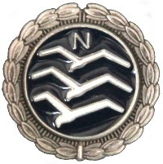
FAI Silver Badge
3 required elements.
Silver Altitude is a 1,000-meter (3,281-foot) altitude gain above an in-flight low point.
Silver Duration is a 5-hour flight time after tow release.
Silver Distance is a 50-km (31.07-mile) cross country flight.

Slide 11
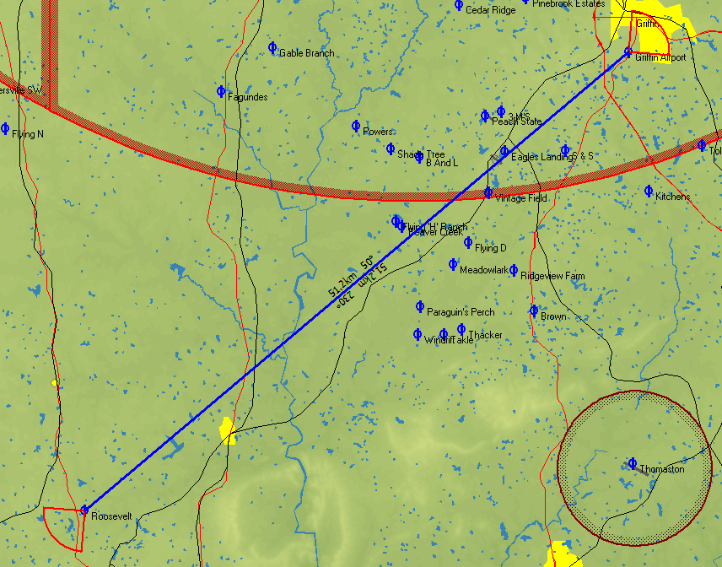
FAI Silver Badge Course 1

Slide 12
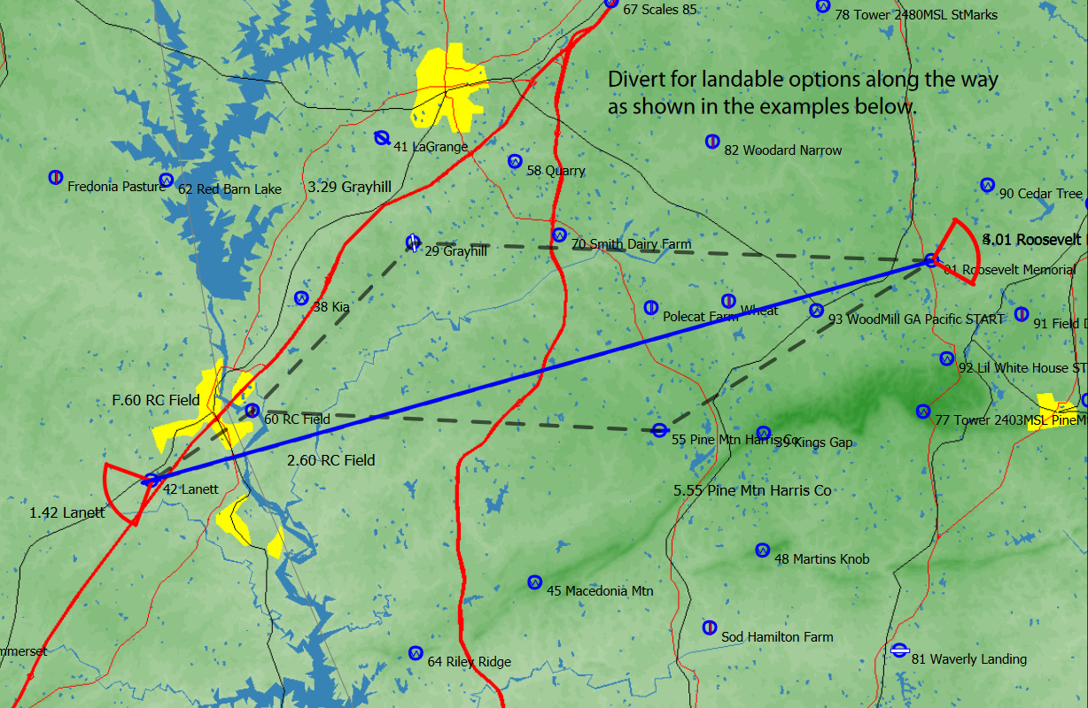
FAI Silver Badge Course Example
Warm Springs Roosevelt to Lanett = 51.9km (32.2miles) one way
Exact course line has few landing options
LaGrange Airport
Roosevelt Airport
RC Field often landable
Pine Mtn Airport
Lanett Airport

Slide 13
FAI Gold Badge
2 required elements.
Gold Altitude is a 3,000-meter (9,843-foot) altitude gain above an in-flight low point; Gold Distance is a 300-km (186.42-mile) cross country flight.

Slide 14
FAI Gold Badge
3 required elements.
Diamond Altitude is a 5,000-meter (16,404-foot) altitude gain above an in-flight low point; Diamond Goal is a 300-km (186.42-mile) cross country flight using a pre-declared Out and Return or Triangle course;
Diamond Distance is a 500-km (310.7-mile) cross country flight.
As of January 1, 1996, a total of 818 Diamond Badges have been awarded in the US among a total of 5,846 worldwide.

Slide 15
Cross country Check lists….
checklist, well developed for pilot, glider, trailer, several hours of food and water, cell phone, Spot tracking, handheld gps/app to nav without cell service, rope, first aid kit etc.

Slide 16
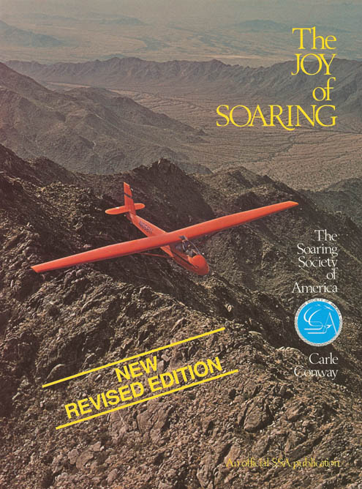
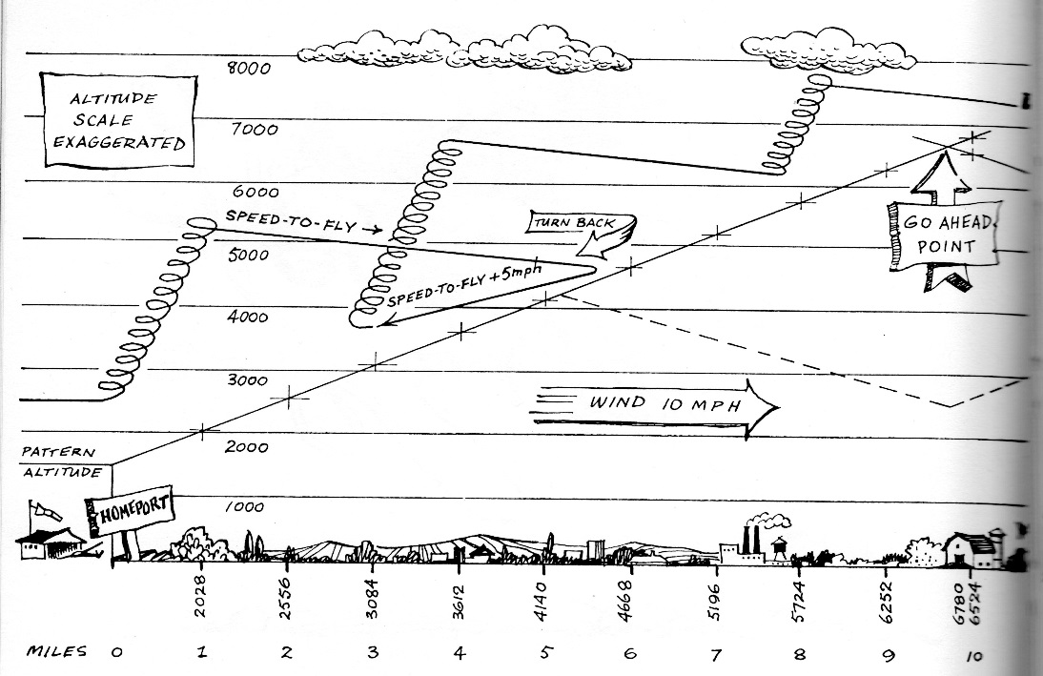
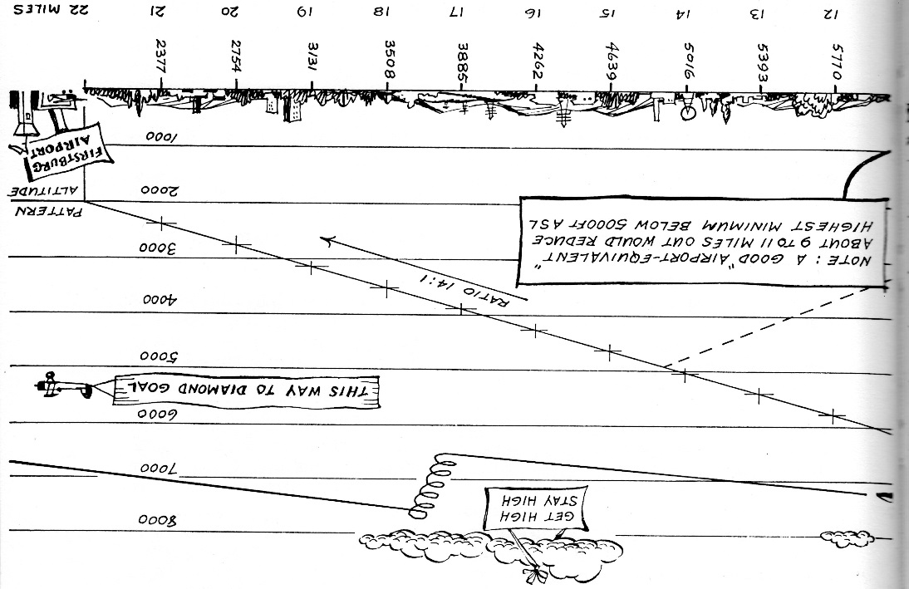
Read….

Slide 17
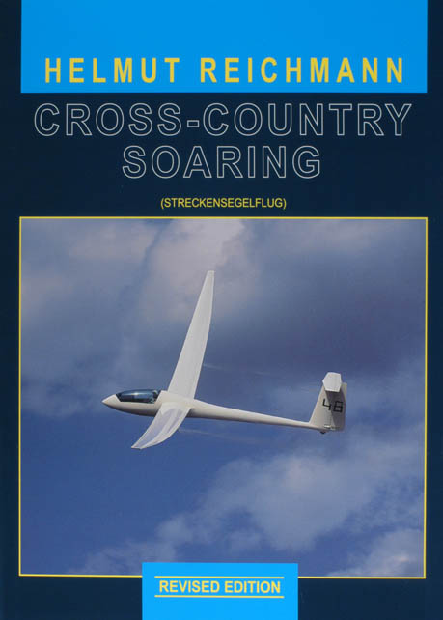
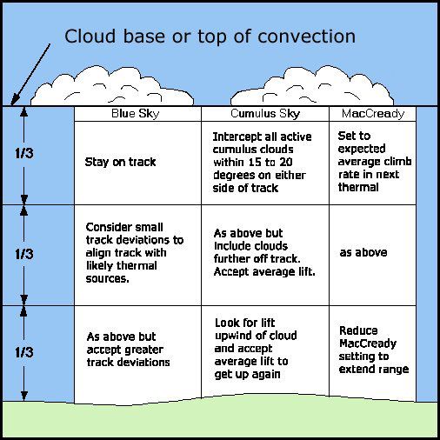
Read….

Slide 18
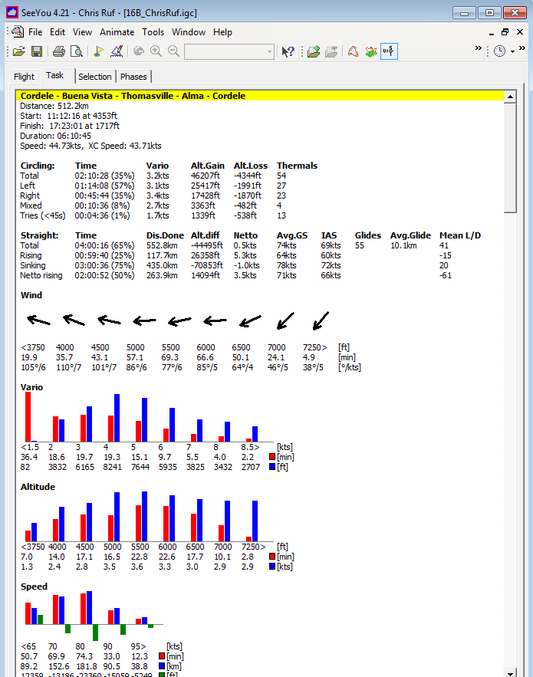
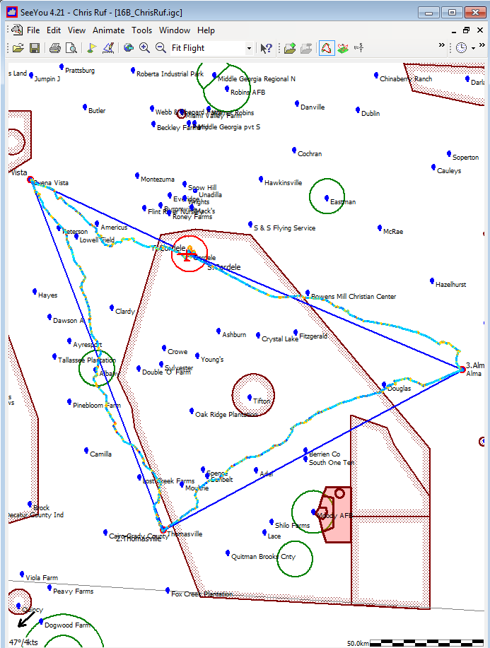
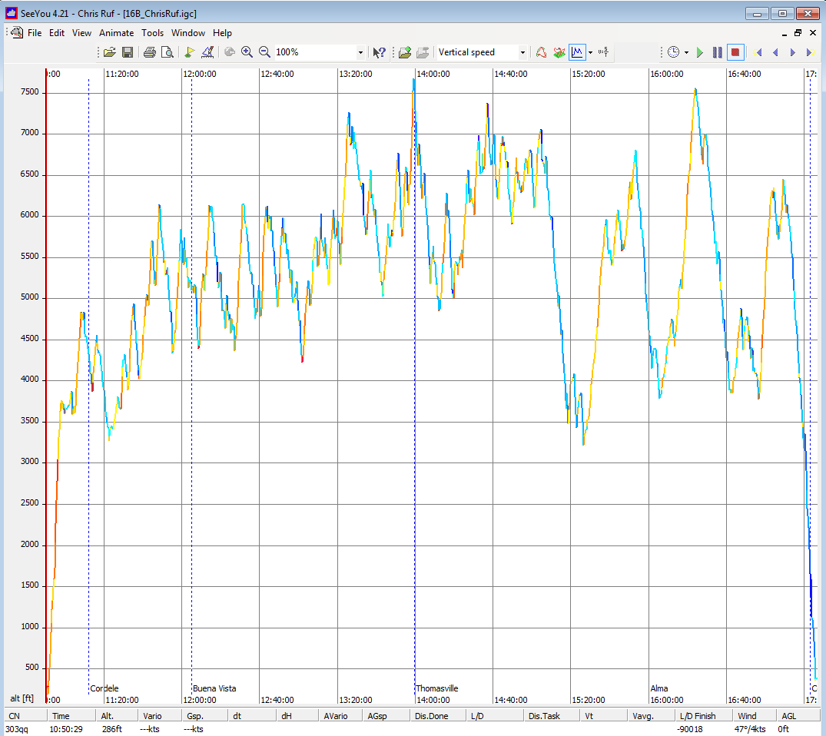
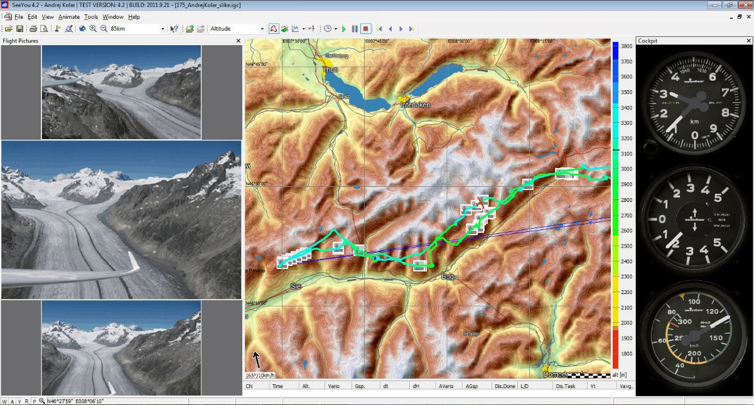
flight analysis, SeeYou
If you can't measure it, you can't improve it. Peter Drucker
SeeYou flight analysis
Task Planning & Google Earth
% climb,
achieved L/D
Distance achieved
Achieved climb rates
OLC onlinecontest.org

Slide 19
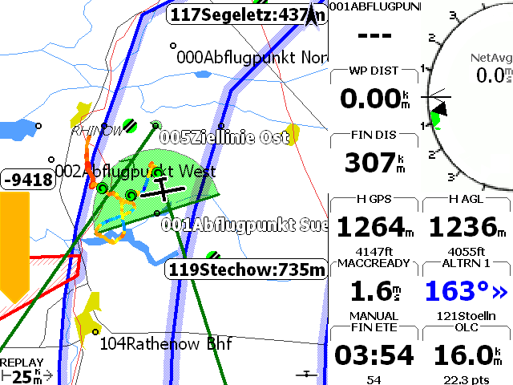
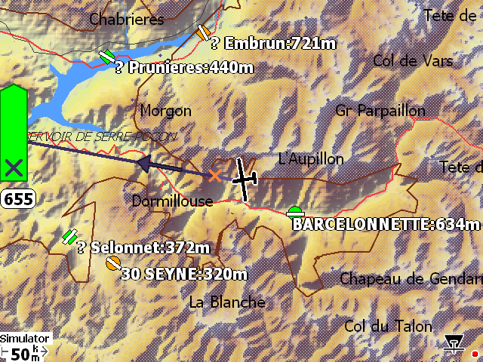
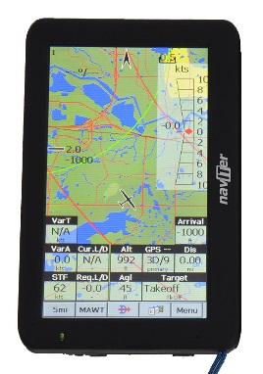
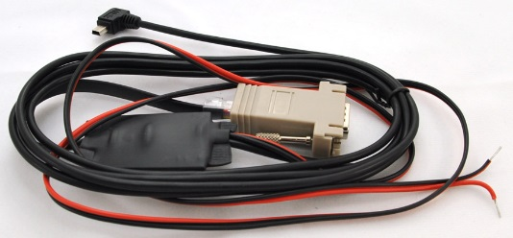
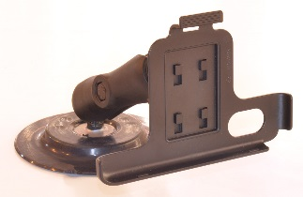
flight software
xcsoar.org
Glide Range
Where are alternates?
Wind
Airspace

Slide 20
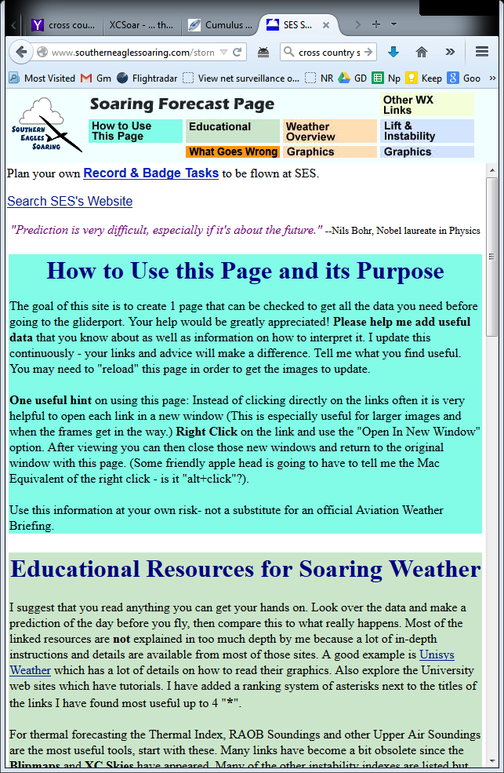
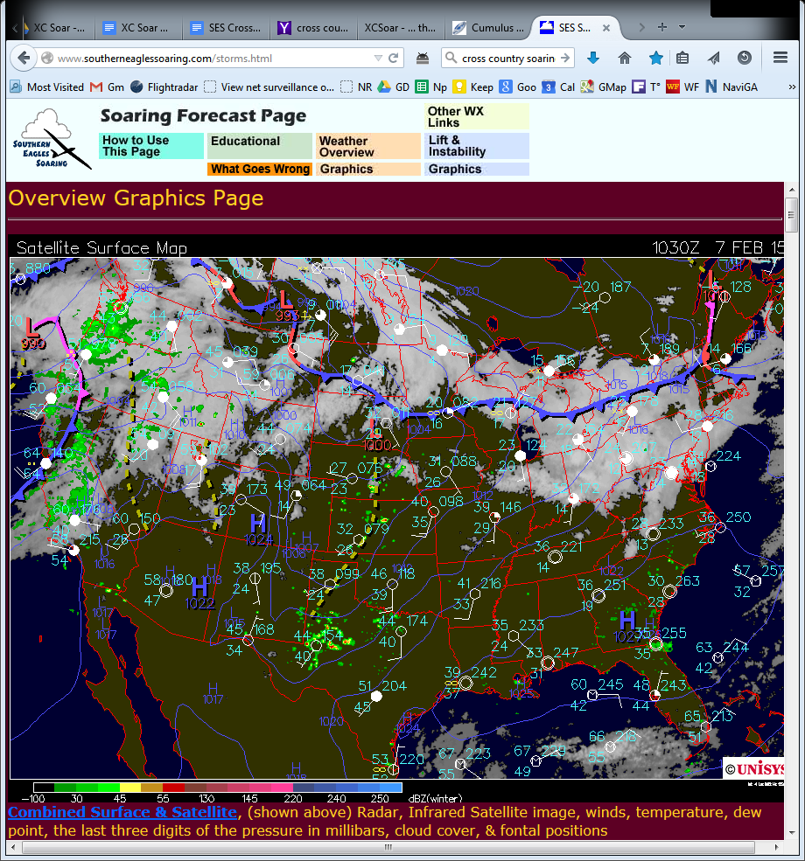
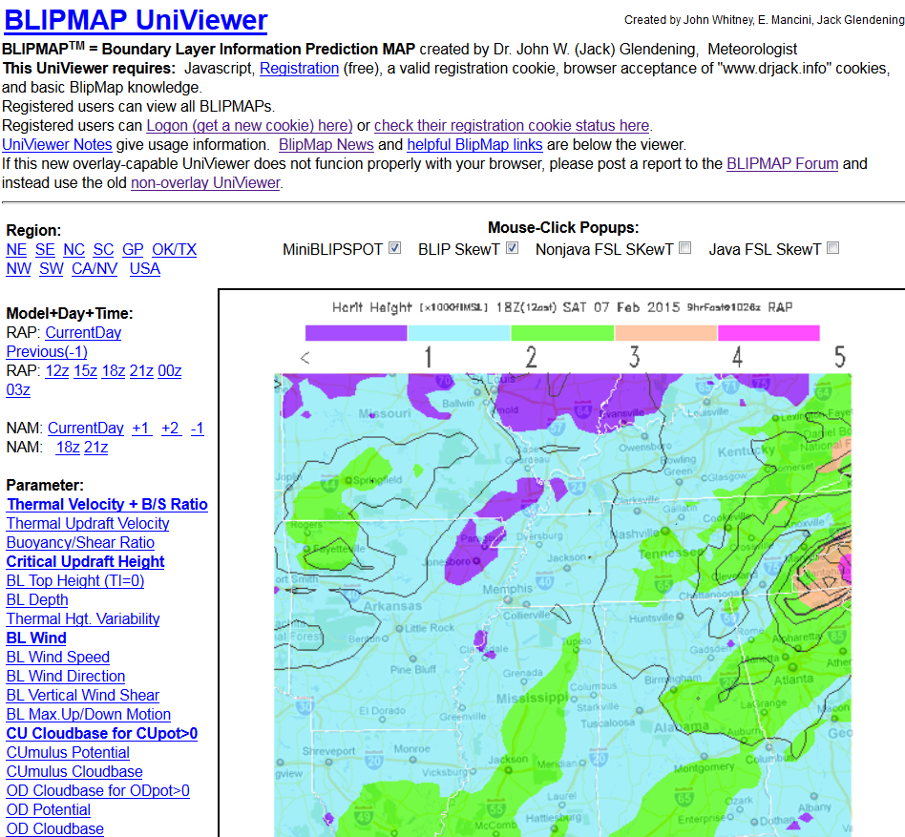
Weather
southerneaglessoaring.com/storms.html
drjack.info Hcrit

Slide 21
Oh, the Places you’ll go… Soaring This Year… What is YOUR Goal?

